Slide 1



CE7454 Object Detection of Ship Images using Deep learning Techniques
15 November 2018
Xu Yan,
Ong Shen Hoong Kevin,
Wang Hong Tao

Slide 2

Objective:
To be able to detect ships from satellite images as quickly as possible using Deep Learning techniques
Source: https://upload.wikimedia.org/wikipedia/commons/7/7c/Kaggle_logo.png

Slide 3
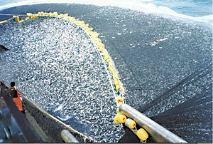
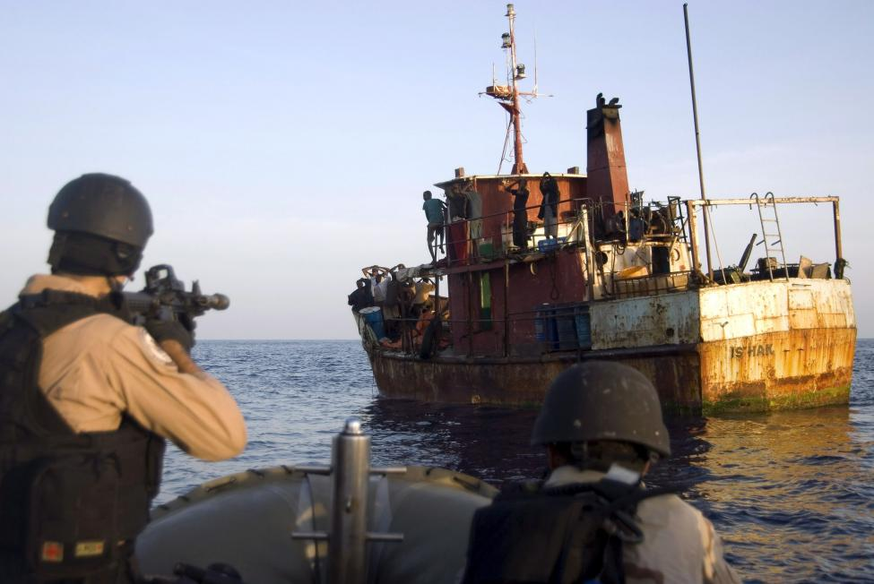

Motivation
Identification of illegal Activities
Source: https://worldoceanreview.com/wp-content/uploads/2013/02/wor2_k3c-s75_3-25_verfolgungsjagd_vor_suedkorea.jpg , https://upload.wikimedia.org/wikipedia/commons/thumb/0/00/Chilean_purse_seine.jpg/300px-Chilean_purse_seine.jpg

Slide 4
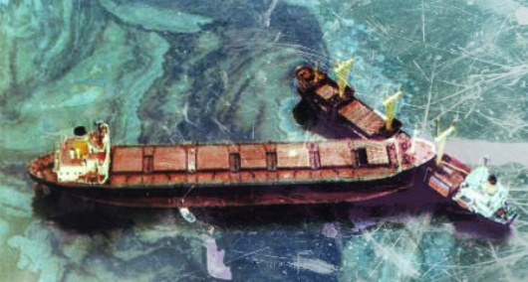
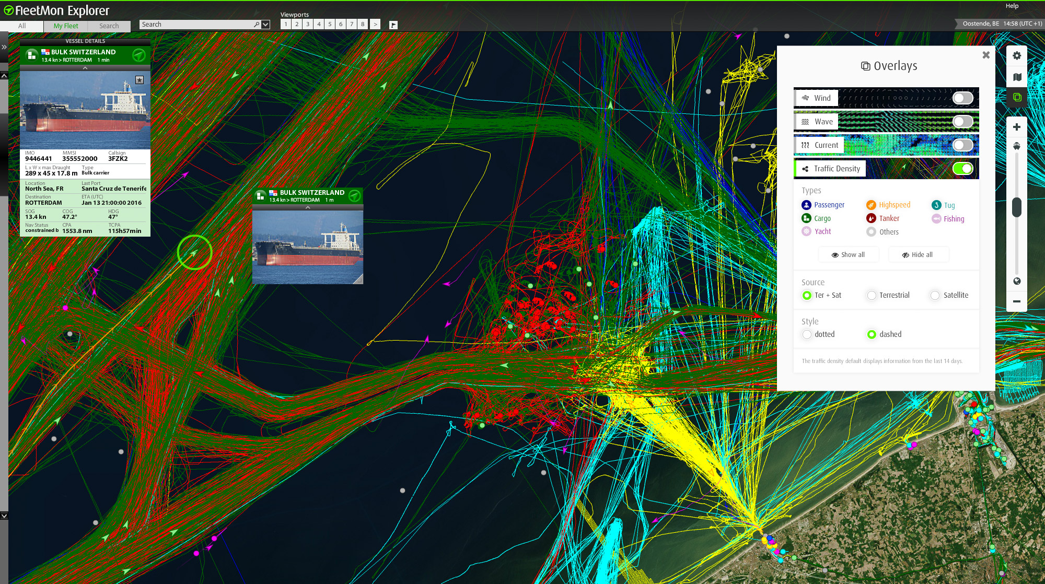

Motivation
Maritime Traffic Monitoring
This Photo by Unknown Author is licensed under CC BY-SA
Source: https://worldoceanreview.com/wp-content/uploads/2013/02/wor2_k3c-s75_3-25_verfolgungsjagd_vor_suedkorea.jpg , https://steamuserimages-a.akamaihd.net/ , https://officerofthewatch.files.wordpress.com/2012/09/2012-09-10-figure-1carrier-collision-causes-oil-spill-in-singapore1.jpg?w=610

Slide 5
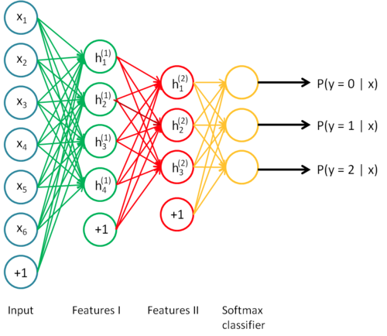
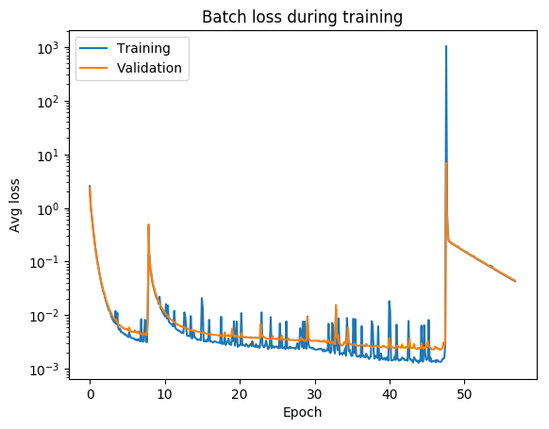

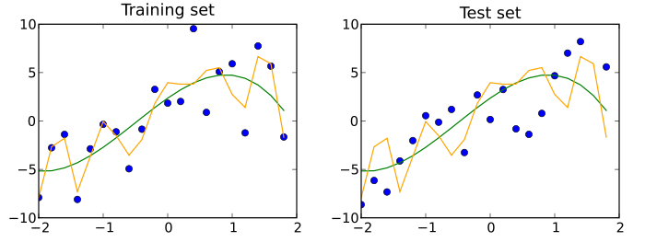
Deep learning Steps
1
3
5
Data Cleaning
+
Prepare
Test Data Validation
Data
Acquisition
+
Exploration
Train model
Analysis + Improve
2
4
Source: https://agsft.com/wp-content/uploads/2016/06/FilterBigData.png , https://cdn-images-1.medium.com/max/1600/1*fk2ZjHyqYH04rLTgvQYs4A.png ,

Slide 6
Deep learning Steps
1
Data Cleaning
+
Prepare
Data
Acquisition
+
Exploration
2
Source: https://agsft.com/wp-content/uploads/2016/06/FilterBigData.png , https://cdn-images-1.medium.com/max/1600/1*fk2ZjHyqYH04rLTgvQYs4A.png ,

Slide 7
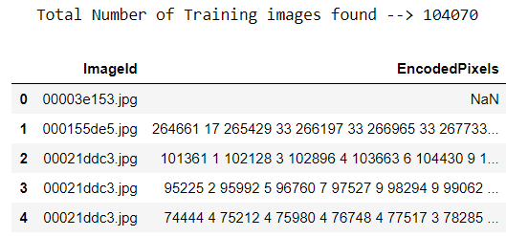
Data Acquisition + Exploration
Decoding required to extract data → Run-Length-Encoding
NULL values are present → Image no ship
Minor data cleaning required

Slide 8
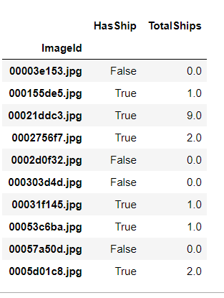
Data Acquisition + Exploration
4 types of data becomes available:
Presence of Ship (F/T)
Number of Ships
Location of Ships
Infer Bounding Box

Slide 9
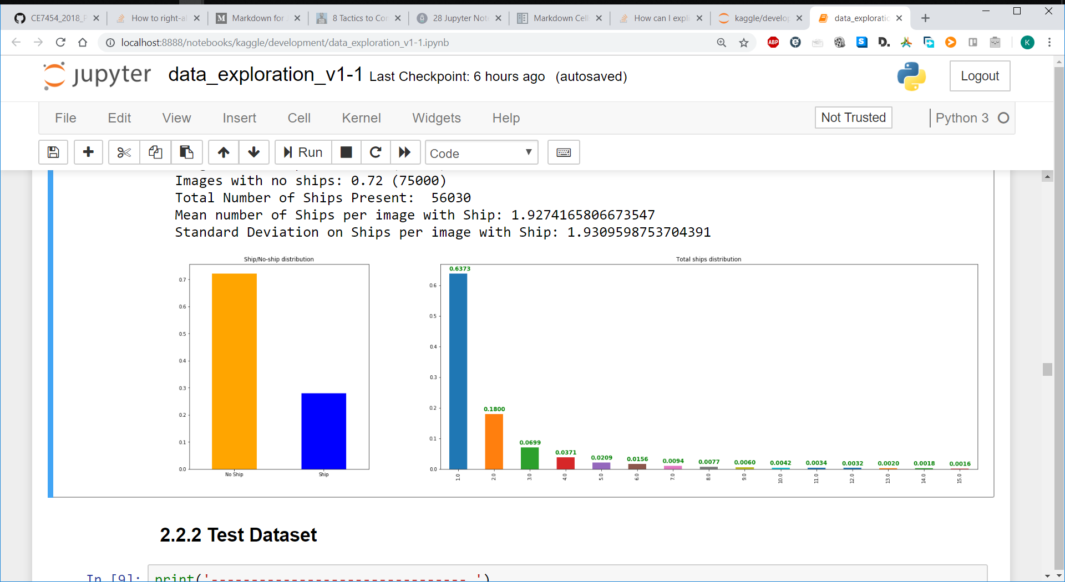
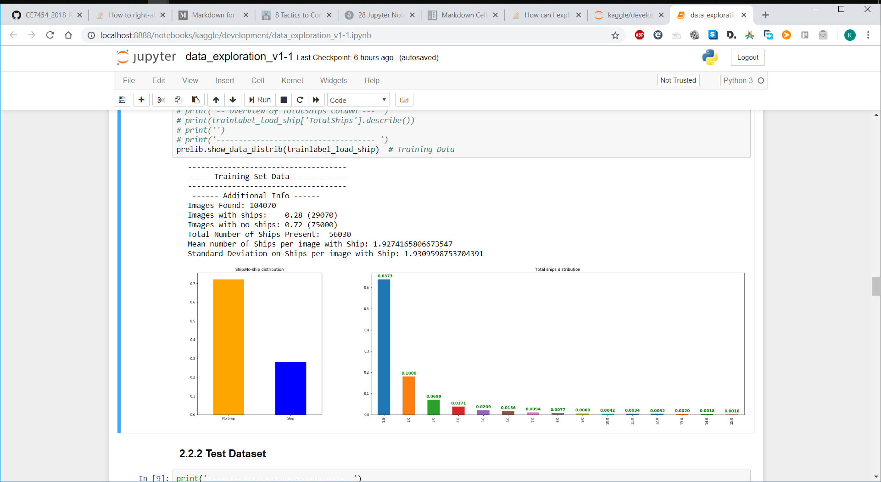
Data Acquisition + Exploration
75%
28%

Slide 10
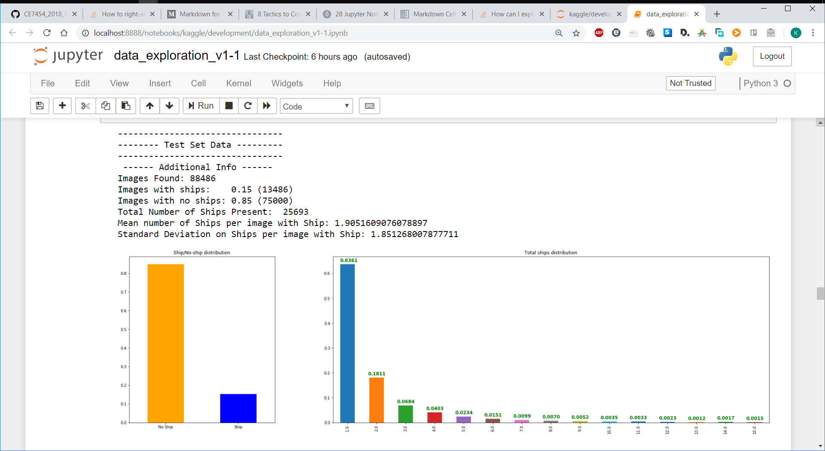
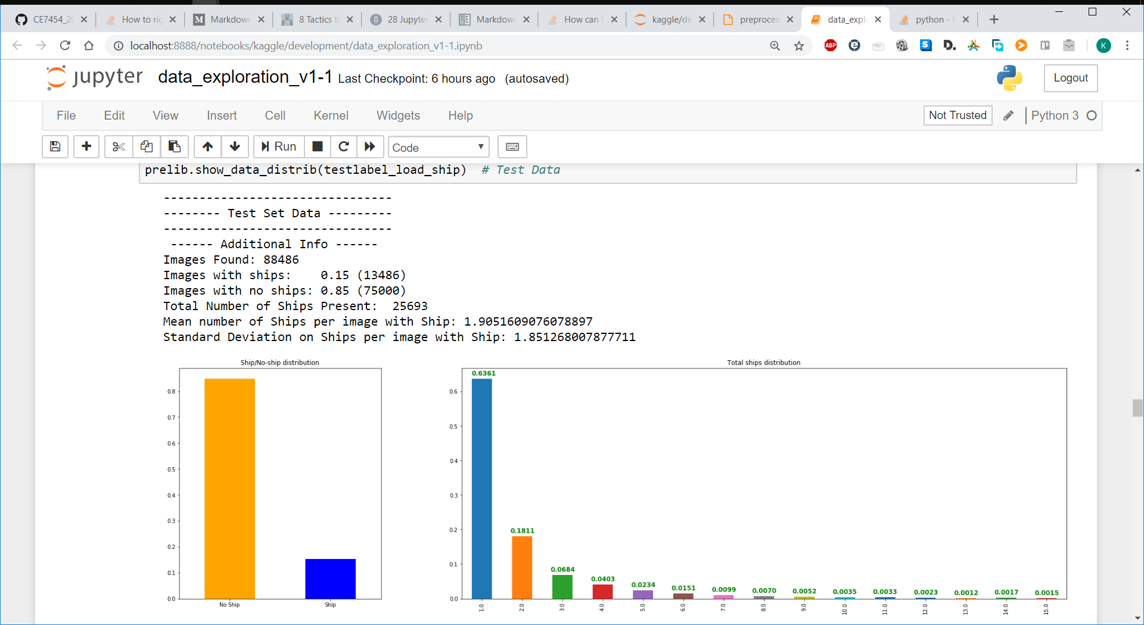
Data Acquisition + Exploration

Slide 11
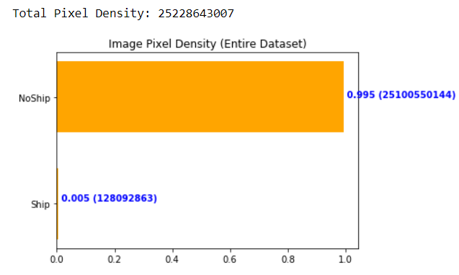
Data Acquisition + Exploration
Huge Difficulty of Ship Detection
Could be further improved by obtaining more data

Slide 12
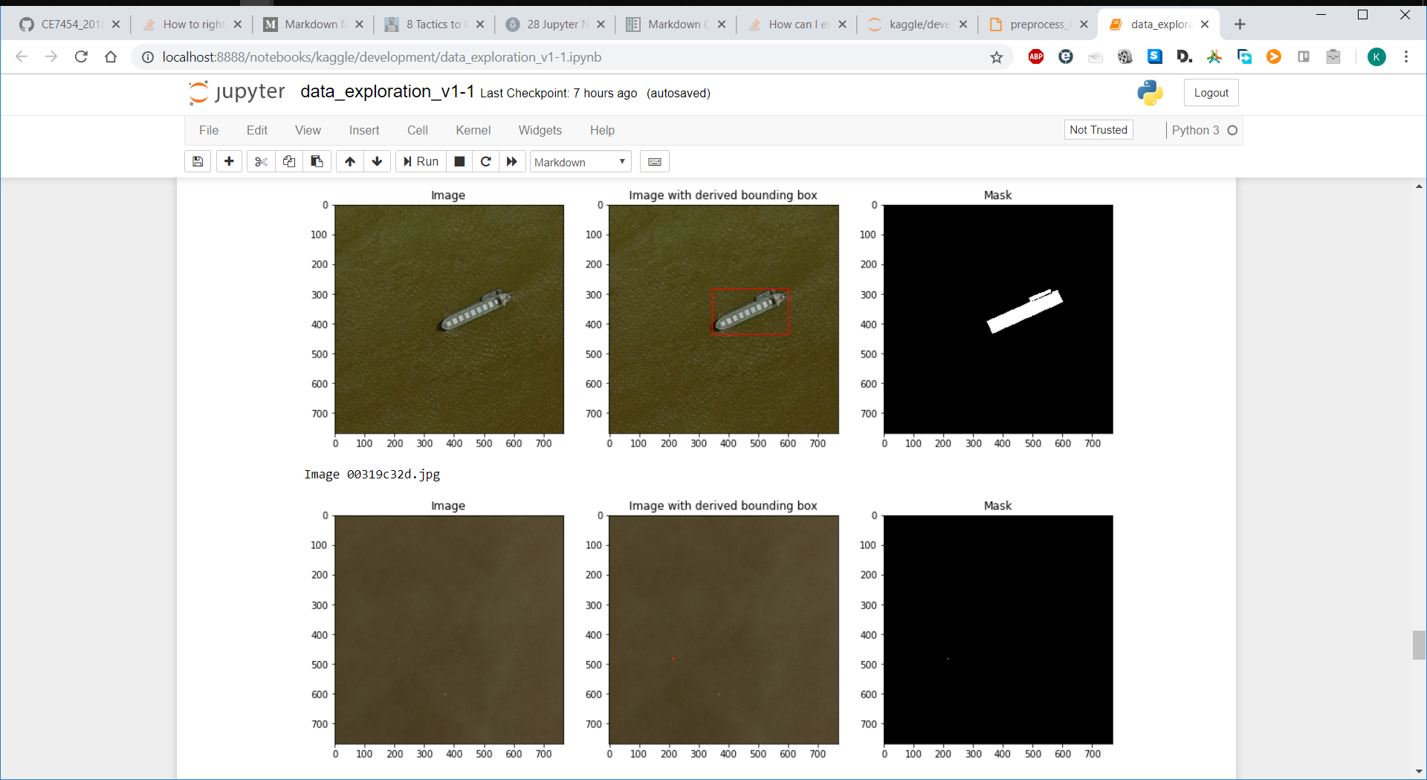
Example of Detection Complexity
2 types of complexity

Slide 13
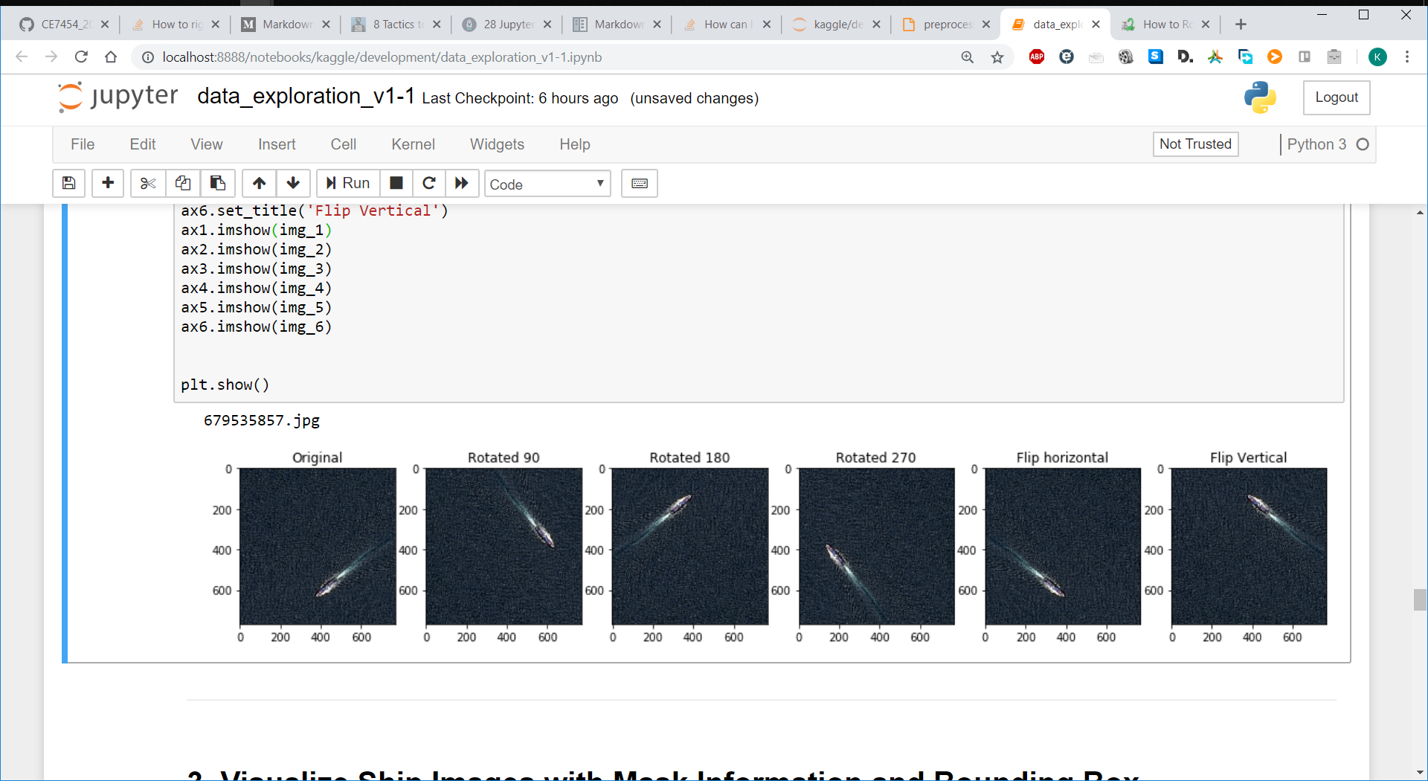
Data Preparation
Image Requires Balancing to avoid a biased classifier
Easily Generate more ship image data (from 30% to ~66%)

Slide 14
Data Preparation
CSV Output dictionary of values containing ImageID and Boundary box Information
Data normalization value is initialized to 0.5 (standard deviation and mean)
Custom library provided (code re-use)
Batch prep files for on-the-fly generation of additional images

Slide 15
Deep learning Steps
3
5
Test Data Validation
Train model
Analysis + Improve
4
Source: https://agsft.com/wp-content/uploads/2016/06/FilterBigData.png , https://cdn-images-1.medium.com/max/1600/1*fk2ZjHyqYH04rLTgvQYs4A.png ,

Slide 17
Deep learning Steps

Slide 18
Conclusion
XXX showed
Ship Detection problem evolved into Image Segmentation
asdasd

Slide 19
Future Improvements
Increase size of dataset
Consider v2 dataset (50% more data)
Obtain raw satellite images
Transfer learning
Benchmark with existing algorithms
Submit to Kaggle competition
Further generalized for other image detection use cases

Slide 20


